Slide 1

FINAL YEAR PROJECT PRESENTATION
NURUL FATIHAH BINTI MOHD RASID (BK13110347)

Slide 2
SECURITY MONITORING SYSTEM FOR LABS BY USING RASPBERRY PI IN FACULTY OF COMPUTING AND INFORMATICS
NURUL FATIHAH BINTI MOHD RASID (BK13110347)

Slide 3
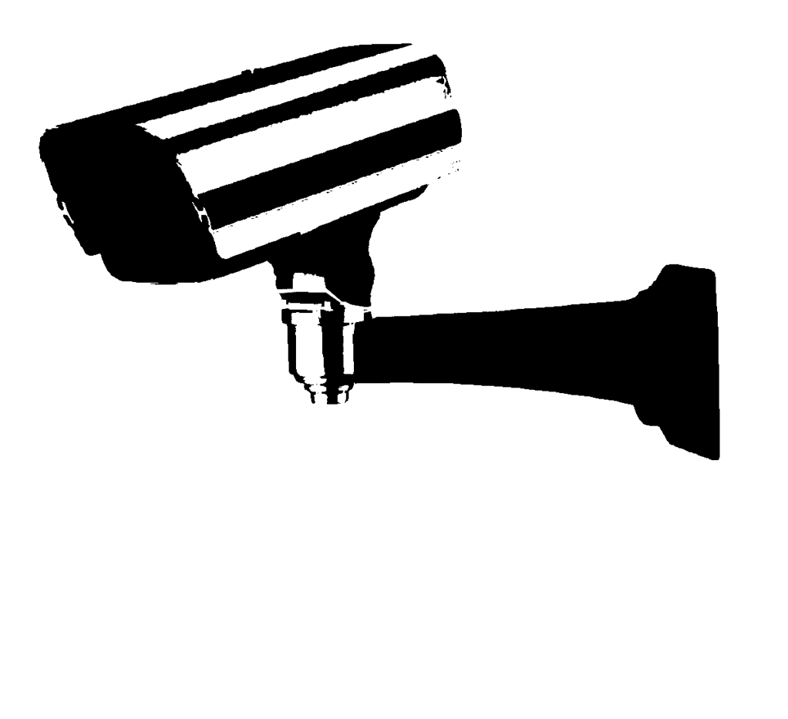
Objectives
To develop a security monitoring system using Raspberry Pi
To configure the security monitoring system more efficiently in the lab
To test the security monitoring system in terms of effectiveness, functionality and user-friendliness

Slide 4
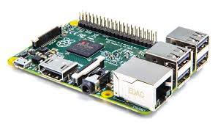
Raspberry Pi
Raspberry Pi known as foundation works to put the power of digital making into hands of people
Raspberry Pi could work as a very capable, very tiny and very cheap modems media centre
It provides low-cost, high performance computer that people use to learn, solve problem and have fun
able to understand and shaping future digital world, able to save problem and equipped for the jobs of the future

Slide 5
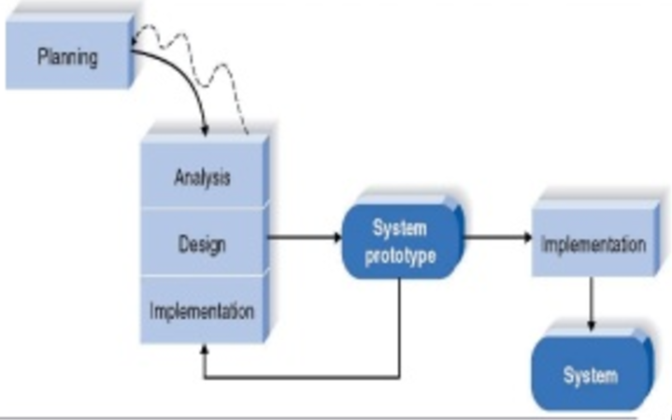
Methodology Used
The prototyping model is systems development (SDM) where doing prototype of product by which an early approximate final system achieved is build, tested and worked as necessary function of product needed

Slide 6
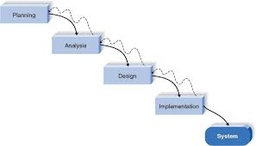
Methodology Used
Waterfall development is a type of structured design methodology, where it is linear and sequential
as the flow goes downwards through the phase step by step

Slide 7
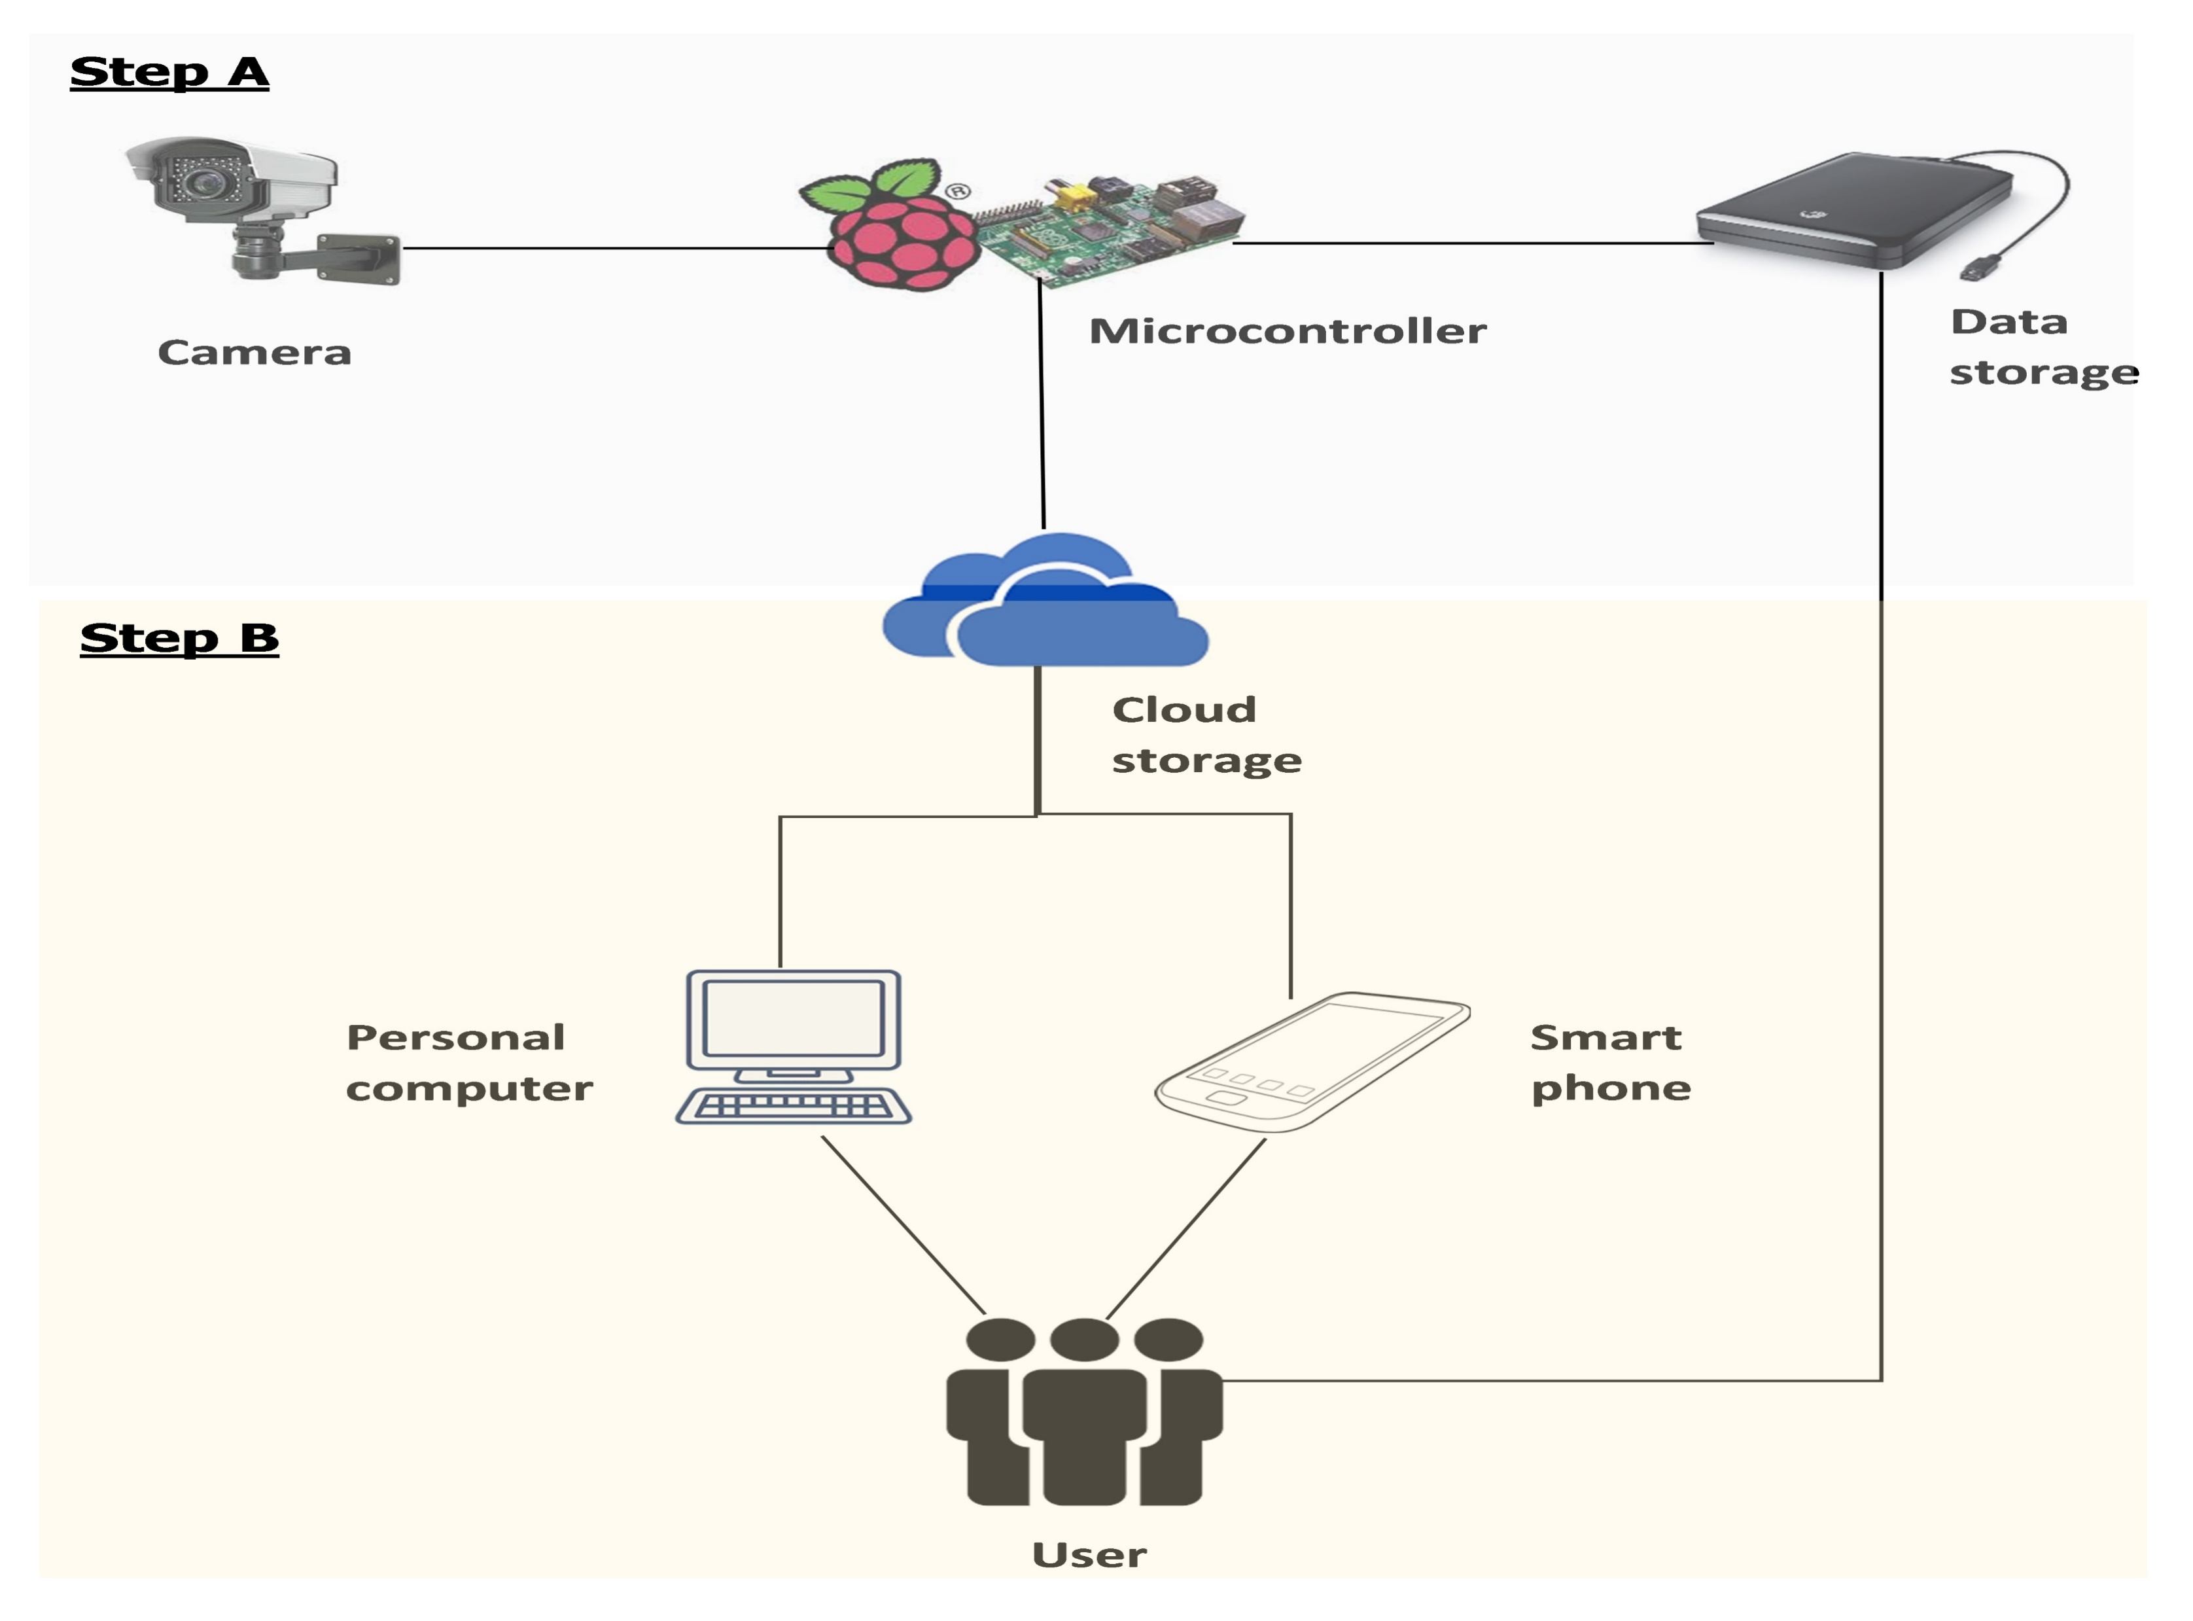
Topology

Slide 8
Step A Configuration
Set A configuration need hardware to configure between camera and connection storage. Testbed project development tool are chosen to complete the system. The camera that will be used is Raspberry Pi camera and the microcontroller is Raspberry Pi B.
To start the configuration, by using SD card download the operating system for Raspberry Pi, which is I decided to used MotionEye operating system. Next, insert it into Raspberry Pi and boot it up using monitor, keyboard mouse Ethernet connection and power supply.
After that set the static IP address for Raspberry Pi, configure the camera and set the data storage to cloud (Google Drive)

Slide 9
Step B Development
implement programming language to develop the website and web view in smart phone interface for system development related in set A configuration result.
design friendly user interface for system
Adobe Dreamweaver software is chosen to develop the design of system
web view function to make it available it smartphone.

Slide 10
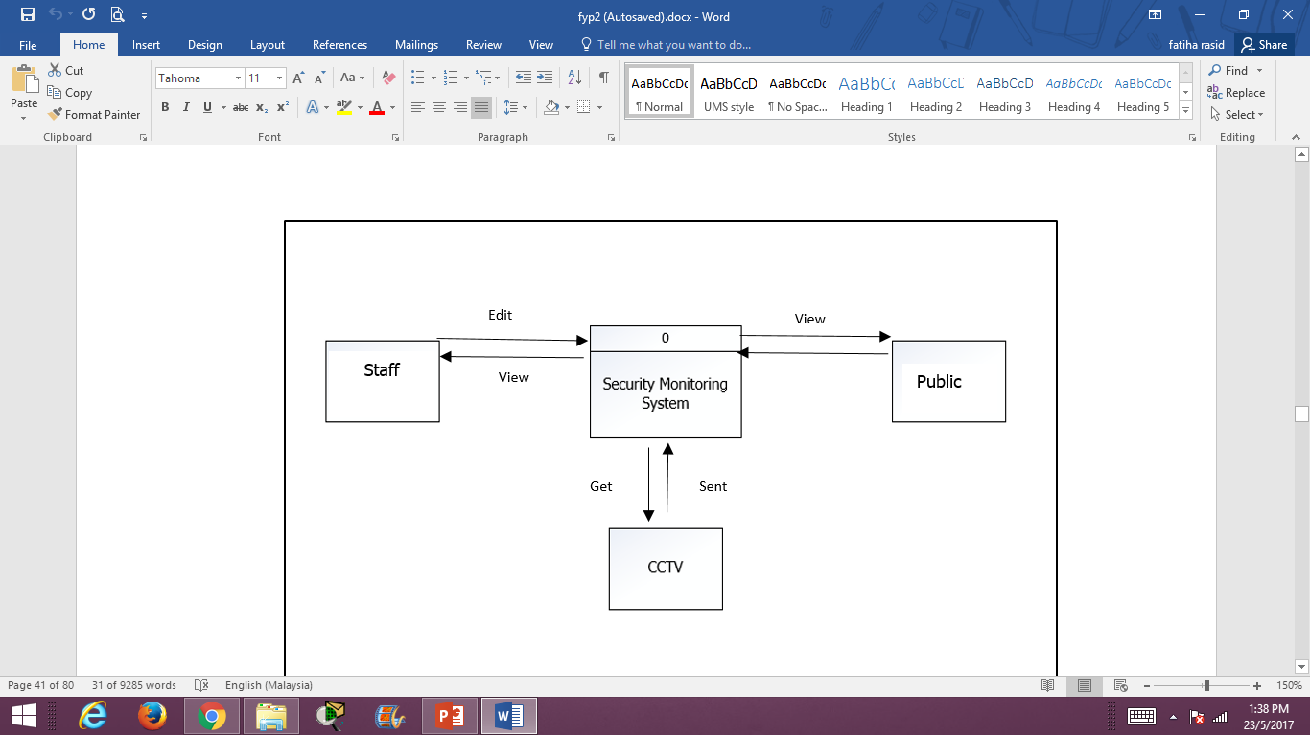
Context Diagram (Data Flow Diagram (DFD)

Slide 11
Work progress
Set A
Research on OS Configuration
Camera installation and Configuration test
Image capture configuration
Data of image capture connect to google drive as server.
Set B
Interface design
Database connection
Login function
Data collection
Data show function
Friendly user interface
Full function test

Slide 12
Conclusion
Developing security monitoring system for CCNA Lab for (FCI) is the solution to solve the problem faced by Lab technician and Lecture. By having a security monitoring system, labs will be secured and the lab equipment’s will be safely intact. There are several problems such as report of missing facilities at the lab such as mouse, cable and others can be preventing.

Slide 13
Work progress demonstration configuration and development

Slide 14
Thank You

